Slide 1

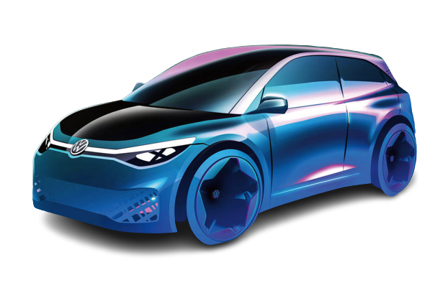
Electric Vehicle performance monitoring dashboard
Sriram R
U22PG507DTS023
1st M.Sc. Data Science

Slide 2
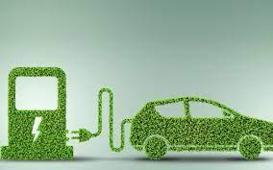
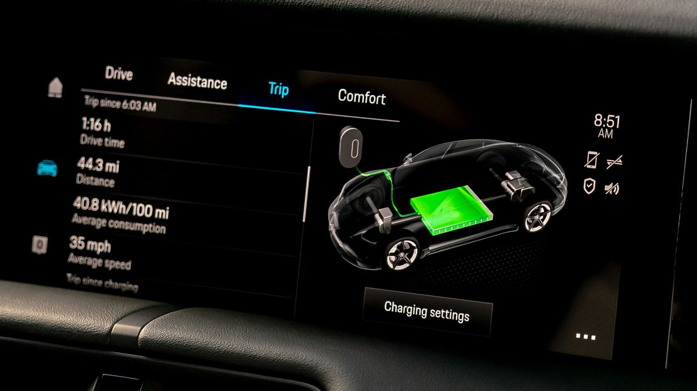
Abstract
Creating dashboards using data visualization tools to analyze electric cars’ performance based on speed, acceleration, battery pack, and fast charging ability for various brand model cars.

Slide 3

Problem Statement
Electric vehicles are getting on the ground now more than ever before. Analyzing different brands’ electric cars’ performance will be a challenging task to identify the key differences among them. Using a dashboard, we can effectively monitor their performance and key differences to know about electric cars.

Slide 4
Literature survey:
My literature survey references:
https://www.kaggle.com/code/prateekiet/electric-vehicle-analysis (Kaggle notebook)
https://github.com/Printalect/Electric-Vehicle-Dashboard-Euro (GitHub repository)

Slide 5
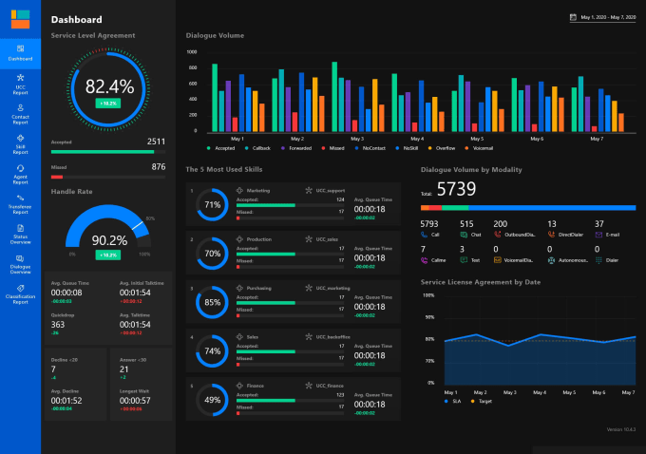
Proposed approach
Using data visualization techniques, we can effectively monitor the various model of electric cars based on their specifications.
Visualization tools can be utilized to create a better monitoring dashboard for various electric car models.
Tools needed Power
BI (For analysis)
Electric car dataset

Slide 6
Working Demo:

Slide 7
Conclusion:
We have monitored the different brands of electric car which is 33 brand and 103 models,
We can say that Brand – Tesla has more brands than the other 32 brands.
Through this, we can monitor the individual brands' electric car performance based on the key features.

Slide 8


